Slide 1
Multimedia Database

Slide 2
Multimedia Database
A multimedia database is a collection of
related multimedia data.
Multimedia data are of type text, image,
audio, video, animations, drawings, sketches,
maps.

Slide 3
A multimedia database management system
supports various data types for management of
media data and facilitates storage and retrieval
of the same.

Slide 4
Media data are large in size and they are
called LOB.
Compression is required to reduce storage
requirement and network load

Slide 5
Multimedia data can be
time independent,
time dependent or
dimensional (3D games, computer aided drafting).

Slide 6
Different types of multimedia data have different
types of elements.
Elements of image are pixels
Elements of video are raster images and graphics
Elements of audio are sound and volume
Elements of graphics are vectors and regions
Elements of text are characters

Slide 7
A multimedia database not only stores and
manages media data but also metadata of media
data
(i) format of media data,
(ii) keywords that describes the media data,
(iii) features of media data - e.g.
color histogram, kinds of texture, other images present in
the image.

Slide 8
Usage of metadata of media data
The media format data is used for display of media
data and
keywords and features are used for indexing
media data.

Slide 9
Multimedia data consists of a variety of media formats
i) tiff, bmp, jpeg, gif, png (images)
ii) mpeg, 3gp (video)
iii) avi, mid, wav (audio)
iv) doc, ppt, pdf (text)

Slide 10
Since there is restriction on conversion between
formats hence a multimedia database
management system should have LOB data types
that support a variety of formats.
Media data take a lot of processing time and
bandwidth.

Slide 11
Large Objects (LOBs) are a set of data types that are
designed to hold large amounts of data.
The maximum size for a single LOB can range is from 8
terabytes to 128 terabytes (in Oracle) depending on
how the database is configured.
Storing data in LOBs enables you to access and
manipulate the data efficiently in your application.

Slide 12
There are a variety of LOB data types:
BLOB Binary Large Object:
It stores any kind of data in binary format. It is typically used
for multimedia data such as images, audio, and video.
CLOB Character Large Object
Stores string data in the database character set format. It is
used for large strings or documents that use the database
character set exclusively. Characters in the database
character set are in a fixed width format.

Slide 13
NCLOB National Character Large Object
Stores string data in National Character Set format. It is used for storing large
strings or documents. It supports characters of varying width format.
BFILE External Binary File
A binary file stored outside of the database in the host operating system file
system, but accessible from database tables. BFILEs can be accessed from your
application on a read-only basis. Use BFILEs to store static data, such as image
data, that is not manipulated in applications. Any kind of data, that is, any
operating system file, can be stored in a BFILE column.

Slide 14
The techniques you use when accessing a cell in a LOB
column differ depending on the state of the given cell.
A cell in a LOB Column can be in one of the following states:
i) NULL - The table cell is created, but the cell holds no locator or value.
ii) Empty - A LOB instance with a locator exists in the cell, but it has no value. The length of the LOB is zero.
iii) Populated - A LOB instance with a locator and a value exists in the cell.

Slide 15
Data types for LOB
CLOB,
NCLOB,
BLOB,
BFILE

Slide 16
Features of MMDbms
Provides features of traditional database
Provide homogeneous framework for storing, processing, retrieving, transmitting and presenting wide variety of multimedia data types.
Huge size of MMDBMS
Manage different types of input, output and storage devices.
- Size of multimedia data is larger than traditional text data. So, it should provide variety of data compression and storage formats for various types of data

Slide 17
It comprises of additional information like keywords to make retrieval rapidly
It consists of information about sampling rate, resolution, frame rate, encoding schema etc. of various media data.
It need to synchronize multiple media types relating to one single multimedia objects.

Slide 18
challenges
Modelling – Working in this area can improve database versus information retrieval techniques thus, documents constitute a specialized area and deserve special consideration.
Design – The conceptual, logical and physical design of multimedia databases has not yet been addressed fully as performance and tuning issues at each level are far more complex as they consist of a variety of formats like JPEG, GIF, PNG, MPEG which is not easy to convert from one form to another.
Storage – Storage of multimedia database on any standard disk presents the problem of representation, compression, mapping to device hierarchies, archiving and buffering during input-output operation. In DBMS, a ”BLOB”(Binary Large Object) facility allows untyped bitmaps to be stored and retrieved.

Slide 19
4.Performance – For an application involving video playback or audio-video synchronization, physical limitations dominate. The use of parallel processing may alleviate some problems but such techniques are not yet fully developed. Apart from this multimedia database consume a lot of processing time as well as bandwidth.
5.Queries and retrieval –For multimedia data like images, video, audio accessing data through query opens up many issues like efficient query formulation, query execution and optimization which need to be worked upon.

Slide 20
A Sample Multimedia Scenario
Consider a police investigation of a large-scale drug operation. This investigation may generate the following types of data
Video data captured by surveillance cameras that record the activities taking place at various locations.
Audio data captured by legally authorized telephone wiretaps.
Image data consisting of still photographs taken by investigators.
Document data seized by the police when raiding one or more places.
Structured relational data containing background information, back records, etc., of the suspects involved.
Geographic information system data remaining geographic data relevant to the drug investigation being conducted.

Slide 21
Possible Queries
Image Query (by example):
Police officer Rocky has a photograph in front of him.
He wants to find the identity of the person in the picture.
Query: “Retrieve all images from the image library in which the person appearing in the (currently displayed) photograph appears”
Image Query (by keywords):
Police officer Rocky wants to examine pictures of “Big Spender”.
Query: "Retrieve all images from the image library in which “Big Spender” appears."

Slide 22
Possible Queries (cont.)
Video Query:
Police officer Rocky is examining a surveillance video of a particular person being fatally assaulted by an assailant. However, the assailant's face is occluded and image processing algorithms return very poor matches. Rocky thinks the assault was by someone known to the victim.
Query: “Find all video segments in which the victim of the assault appears.”
By examining the answer of the above query, Rocky hopes to find other people who have previously interacted with the victim.
Heterogeneous Multimedia Query:
Find all individuals who have been photographed with “Big Spender” and who have been convicted of attempted murder in South China and who have recently had electronic fund transfers made into their bank accounts from ABC Corp.

Slide 23
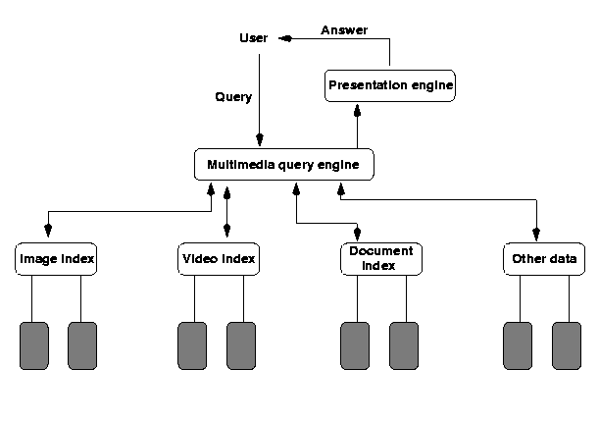
MM Database Architectures
Based on Principle of Autonomy
Each media type is organized in a media-specific manner suitable for that media type
Need to compute joins across
different data structures
Relatively fast query
processing due to
specialized structures
The only choice for legacy
data banks

Slide 24
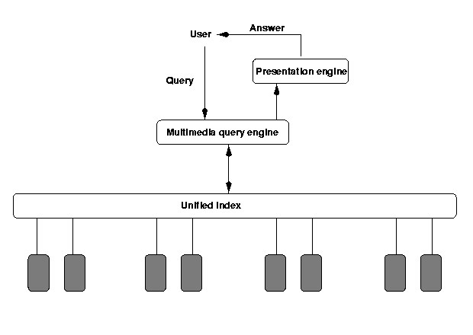
MM Database Architectures (cont.)
Based on Principle of Uniformity
A single abstract structure to index all media types
Abstract out the common part of different media types (difficult!) - metadata
One structure - easy implementation
Annotations for different
media types

Slide 25
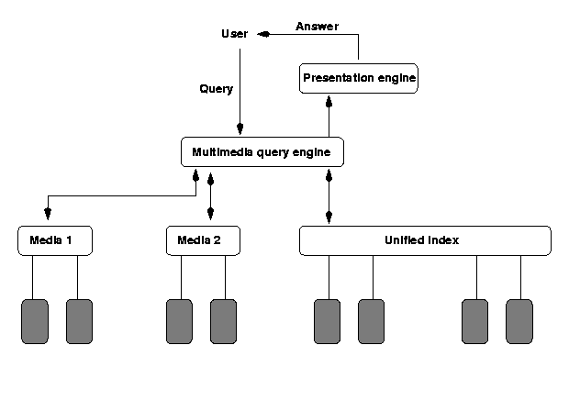
MM Database Architectures (cont.)
Based on Principle of Hybrid Organization
A hybrid of the first two. Certain media types use their own indexes, while others use the "unified" index
An attempt to capture
the advantages of the
first two
Joins across multiple
data sources using their
native indexes

Slide 26
Application areas
Digital library
News-on-demand
Music database
Video-on-demand
Telemedicine
GIS

Slide 27
Application areas of Oracle multimedia
Repositories for digital check images
Electronic health records
Call centers
Physical asset inventories
Distance learning and online learning
Real estate marketing
Stock photography archives

Slide 28
Application areas of Oracle multimedia
Document imaging archives
Financial news service customer information
Web publishing
Audio and video Web stores

